Slide 1
A Clear and Present Danger: Understanding NIST’s Proposed March-in Framework and its Impact on Innovation
January 29, 2024

Slide 2
Agenda
Overview
Current March-in Provisions
Overview of the NIST Guidance Framework
AUTM’s Comments
What Our Membership Can Do

Slide 3
Mission
The Bayh-Dole Act
(P.L. 96-517, Patent and Trademark Act Amendments of 1980)
Created a uniform patent policy among the many federal agencies that fund research, enabling small businesses and non-profit organizations, including universities, to retain title to inventions made under federally-funded research programs.

Slide 4
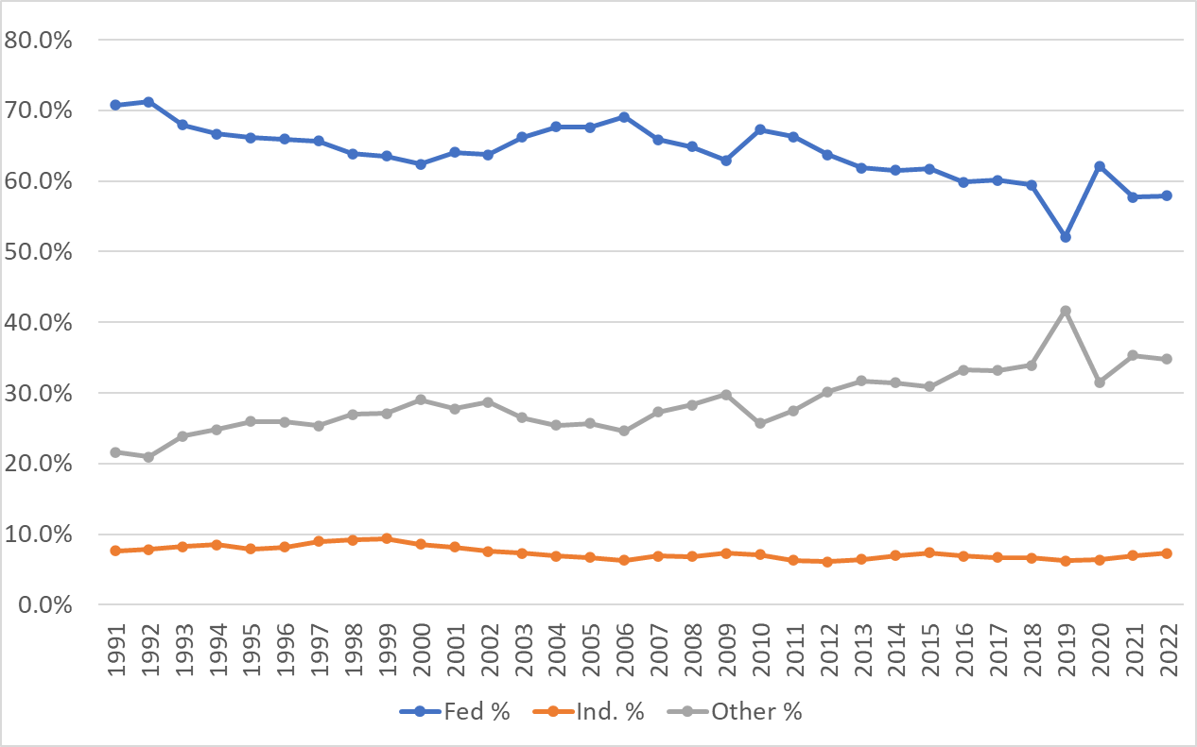
Mission
US University Funding by Type

Slide 5
Mission
March-in History
8 March-in Right petitions have been filed
ALL of them have been denied (by both Democratic and Republican Administrations)
Latest example (Xtandi):

Slide 6
Mission
Draft Interagency Guidance Framework
12/8/2023
NIST releases draft interagency Guidance Framework for Considering the Exercise of March-in Rights.
The goal of the framework document is to provide funding agencies with clear guidance on when to use march-in rights.
March-in available "[i]f the contractor or licensee has commercialized the product, but the price or other terms at which the product is currently offered to the public are not reasonable."
2/6/2024 (5pm ET)
Comments due to NIST (currently 42K comments).
NIST, along with the Interagency Working Group for Bayh-Dole, will use the public comments to develop a final framework document for federal agencies.

Slide 7
Mission
Four Circumstances for March-in Rights
action is necessary because the contractor or assignee has not taken, or is not expected to take within a reasonable time, effective steps to achieve practical application of the subject invention in such field of use;
action is necessary to alleviate health or safety needs which are not reasonably satisfied by the contractor, assignee, or their licensees;
action is necessary to meet requirements for public use specified by Federal regulations and such requirements are not reasonably satisfied by the contractor, assignee, or licensees; or
action is necessary because the agreement required by section 204 [domestic manufacture requirement for exclusive licensees sold in the U.S.] has not been obtained or waived or because a licensee of the exclusive right to use or sell any subject invention in the United States is in breach of its agreement obtained pursuant to section 204

Slide 8
Mission
Sens. Bayh & Dole on Pricing
"Our Law Helps Patients Get New Drugs Sooner"
Washington Post article by Sen. Birch Bayh and Sen. Bob Dole
"Bayh-Dole did not intend that government set prices on resulting products. The law makes no reference to a reasonable price that should be dictated by the government. This omission was intentional; the primary purpose of the act was to entice the private sector to seek public-private research collaboration rather than focusing on its own proprietary research."

Slide 9
Mission
Sens. Bayh & Dole on Pricing (ctd.)
"The ability of the government to revoke a license granted under the act is not contingent on the pricing of a resulting product or tied to the profitability of a company that has commercialized a product that results in part from government-funded research. The law instructs the government to revoke such licenses only when the private industry collaborator has not successfully commercialized the invention as a product."

Slide 10
Pricing & March-in Rights Petitions
"The NIH believes that the extraordinary remedy of march-in is not an appropriate means of controlling prices. The issue of whether drugs should be sold in the United States for the same price as they are sold in Canada and Europe has global implications and, thus, is appropriately left for Congress to address legislatively." (Xalatan Petition, 2004)
"The NIH continues to agree with the public testimony in 2004 that the extraordinary remedy of march-in is not an appropriate means of controlling prices of drugs broadly available to physicians and patients." (Norvir Petition, 2013)
NIH "continues to believe the broader issue of drug pricing would be most appropriately addressed through legislative channels to develop remedies that have implications for the cost of healthcare overall." (Xtandi Petition, 2017)

Slide 11
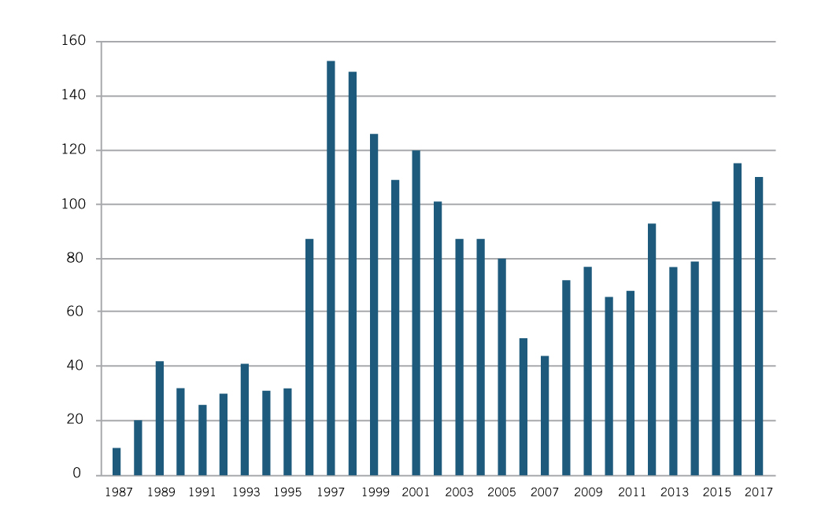
“Reasonable Pricing” Clause Stunted Innovation
NIH imposed “reasonable price” requirements on CRADAs in 1990; NIH repealed them in 1995.
Varmus: “The pricing clause has driven industry away from potentially beneficial scientific collaborations.”
NIH New CRADAs Per Fiscal Year, 1987-2017
Source: NIH Annual Reports; Joseph Allen, “Compulsory Licensing for Medicare Drugs– Another Bad Idea from Capitol Hill”

Slide 12
Mission
(Incorrect) Pricing Argument
action is necessary because the contractor or assignee has not taken, or is not expected to take within a reasonable time, effective steps to achieve practical application* of the subject invention in such field of use;
action is necessary to alleviate health or safety needs which are not reasonably satisfied by the contractor, assignee, or their licensees;
action is necessary to meet requirements for public use specified by Federal regulations and such requirements are not reasonably satisfied by the contractor, assignee, or licensees; or
action is necessary because the agreement required by section 204 [generally requiring that patented products be manufactured substantially in the United States unless domestic manufacture is not commercially feasible] has not been obtained or waived or because a licensee of the exclusive right to use or sell any subject invention in the United States is in breach of its agreement obtained pursuant to section 204
* “Practical application” means to manufacture in the case of a composition or product, to practice in the case of a process or method, or to operate in the case of a machine or system; and, in each case, under such conditions as to establish that the invention is being utilized and that its benefits are to the extent permitted by law or Government regulations available to the public on reasonable terms.

Slide 13
Mission
(Incorrect) Pricing Argument (ctd.)
NIST's rewrite of "practical application" in Criterion 1:
March-in available "[i]f the contractor or licensee has commercialized the product, but the price or other terms at which the product is currently offered to the public are not reasonable."
Agency may consider "factors that unreasonably limit availability of the invention to the public, including the reasonableness of the price and other terms at which the product is made available to end-users."

Slide 14
Mission
(Incorrect) Pricing Argument (ctd.)
2. NIST's rewrite of "health or safety needs which are not reasonably satisfied" in Criterion 2:
"Is the contractor or the licensee exploiting a health or safety need in order to set a product price that is extreme and unjustified given the totality of circumstances?"
"[T]he agency is not limited to reviewing price increases; the initial price may also be considered if it appears that the price is extreme, unjustified, and exploitative of a health or safety need."

Slide 15
Mission
Overview of AUTM's Comments
The Draft Guidelines do not align with the letter and intent of the Bayh-Dole Act.
Implementation of the Draft Guidelines will do little to nothing to reduce drug costs; in fact, it will likely have the opposite effect.
These Draft Guidelines will chill investment in federally funded technologies and drive industry to sever its academic collaborations out of fear of being “contaminated by federal funding.”
https://autm.net/about-tech-transfer/autm-insight-newsletter/autm-updates/join-the-fight-against-march-in-rights

Slide 16
Mission
Overview of AUTM's Comments
The Draft Guidelines do not align with the letter and intent of the Bayh-Dole Act.
The Draft Guidelines act to amend and distort the Bayh-Dole Act.
The Draft Guidelines directly conflict with the intent – and 43+ years of the U.S. government’s interpretation – of the Bayh-Dole Act.
Implementation of the Draft Guidelines will do little to nothing to reduce drug costs; in fact, it will likely have the opposite effect.
U.S. taxpayers greatly benefit from having strong, robust public-private partnerships.
The Draft Guidelines will dismantle and create barriers for public-private partnerships, and the U.S.’s economy, taxpayers and patients will suffer as a result.
The Draft Guidelines are akin to proactively running a bulldozer over a fruitful garden out of fear of weeds, when there are few (if any) weeds to pull.
What constitutes a “reasonable price” is difficult to define, is subjective, and will send investors and industry running away.

Slide 17
Mission
Overview of AUTM's Comments
These Draft Guidelines will chill investment in federally funded technologies and drive industry to sever its academic collaborations out of fear of being “contaminated by federal funding.”
The Draft Guidelines will severely chill private investment in federally funded technologies across industry sectors.
The Draft Guidelines will drive industry to sever its collaborations with academic researchers, inflicting substantial damage on the U.S. economy and patients.
The Draft Guidelines will compel industry to shun federally funded technologies and they will wither on the vine, just like they did in the pre-Bayh-Dole days.

Slide 18
Mission
Overview of AUTM's Comments
"In its Request For Information, NIST asks five questions to help it shape future usage of march-in rights. AUTM has determined that, given the underlying premise in all of NIST’s questions is incorrect (i.e., that the Draft Guideline’s expansion of march-in rights is legal and will lower drug prices without harming American innovation), AUTM will not attempt to improve the fatally flawed process proposed by NIST."
"Before upending 40+ years of legislation, we encourage NIST/the Administration to fully engage stakeholders (beyond the limited 60-day comment period provided) and commission a study on the impact of these Draft Guidelines on U.S. innovation, the U.S. economy, and the public good."
AUTM is also signing on to another coalition letter requesting that the Draft Guidelines be rescinded.

Slide 19
So....What Can YOU Do to Make a Difference?
Make sure your organization files its comments with NIST by next Tuesday (Feb. 6th 5pm ET) – at this point we have not gotten an extension of that date
Review the comments sent to you by AUTM
Be sure to add any local examples or stories from your own campus or institution
Use the link provided to file your comments with NIST once ready
Once you have finalized your comments, WORK WITH YOUR FEDERAL RELATIONS TEAM to SHARE YOUR COMMENTS WITH YOUR CONGRESSIONAL DELEGATION, as well as state and local officials
Encourage THEM to voice their concerns about this proposed plan
Let them know this plan could seriously reduce your ability to spin off new technologies, create new industries and more jobs regionally

Slide 20
So....What Can YOU Do to Make a Difference?
3. Make sure others on your own campus understand why your institution filed the comments it did
Your senior administrators and your university president
Members of your board of regents
Senior research and economic development officers
Regional research and economic development collaborations
4. Keep up the drum beat even after the February 6th date
Any final decisions may be weeks or months away
We need to keep up the pressure on NIST not to include "reasonable pricing" in its march-in guidelines
See if your institution will do an op-ed locally
If the government wants to deal with drug pricing, there are other ways besides turning the Bayh-Dole law on its head

Slide 21
Questions?

