Slide 1
15-Minute Friday – New Members
February 21, 2025
Presenter: Mike Frale, AUTM Membership and Community Engagement Manager

Slide 2
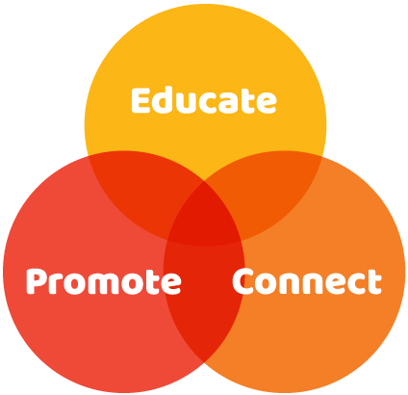
Our Pillars

Slide 3
Educate: In Person Courses
AUTM University
Essentials
Operations and Compliance
Startup
Software
The Conversation: Leadership Forum
In tandem with the Annual Meeting
Marketing
Technology Valuation
Leadership Communications
Negotiations

Slide 4
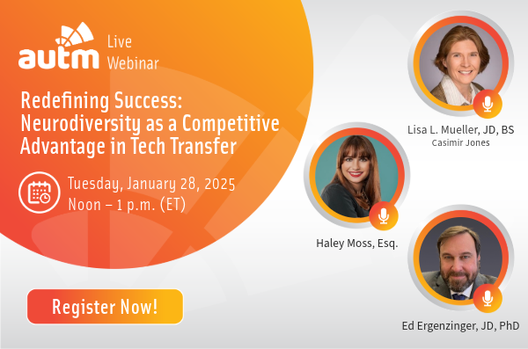
Educate: Online Professional Development
20+ Webinars annually, including
AI-enabled TTO
Innovation Ambassador Program
Navigating Pitfalls and Maximizing Partnering Successes
On-Demand Courses
Negotiations
Essentials of Academic TT
More than 300 archived webinars

Slide 5
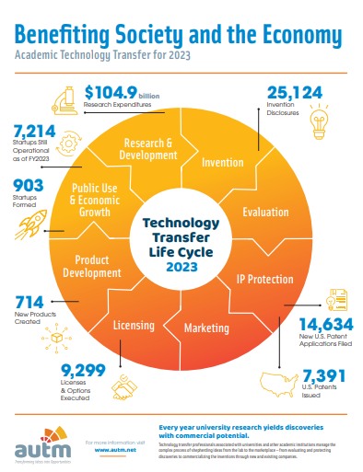
In the past 25 years…
Educate: Surveys, Databases and Toolkits
Annual Licensing Activity Survey
Salary Survey
TransACT (Deals) Database
Toolkits
Women Inventor’s Toolkit
TTO-VC Term Sheet Template
Director’s Toolkit
EDI Toolkit

Slide 6
Promote: AUTM Better World Project
Innovations driving a Better World

Slide 7
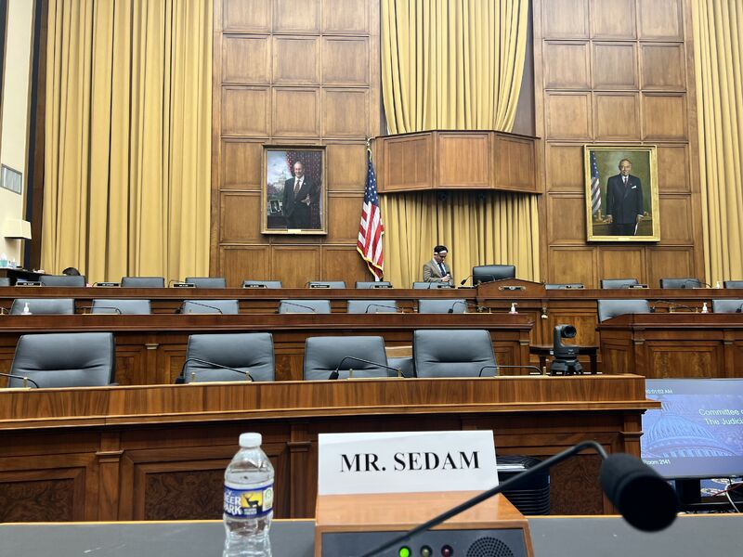
Promote: Advocacy Making a Difference
Past AUTM Chair Marc Sedam testifies in front of the House Judiciary Subcommittee on IP
AUTM Speaks Out Website
AUTM released 14 statements in 2024 on tech transfer including:
Support for PREVAIL, PERA and IDEA Acts
Impact of Proliferation of AI and Determinations of Patentability
Quarterly Advocacy Watercoolers
Last Jan 15th – Recording available

Slide 8
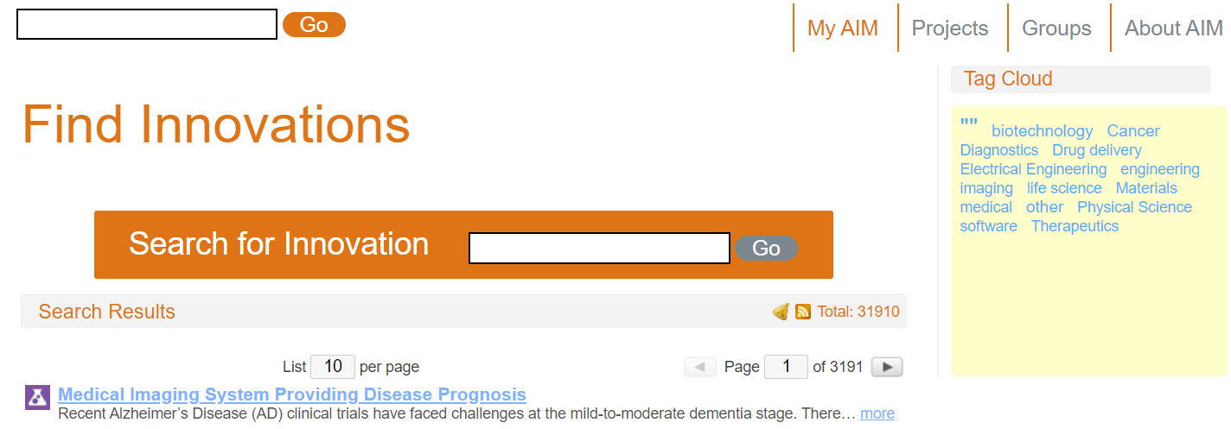
Connect: Externally
www.aim.autm.net

Slide 9
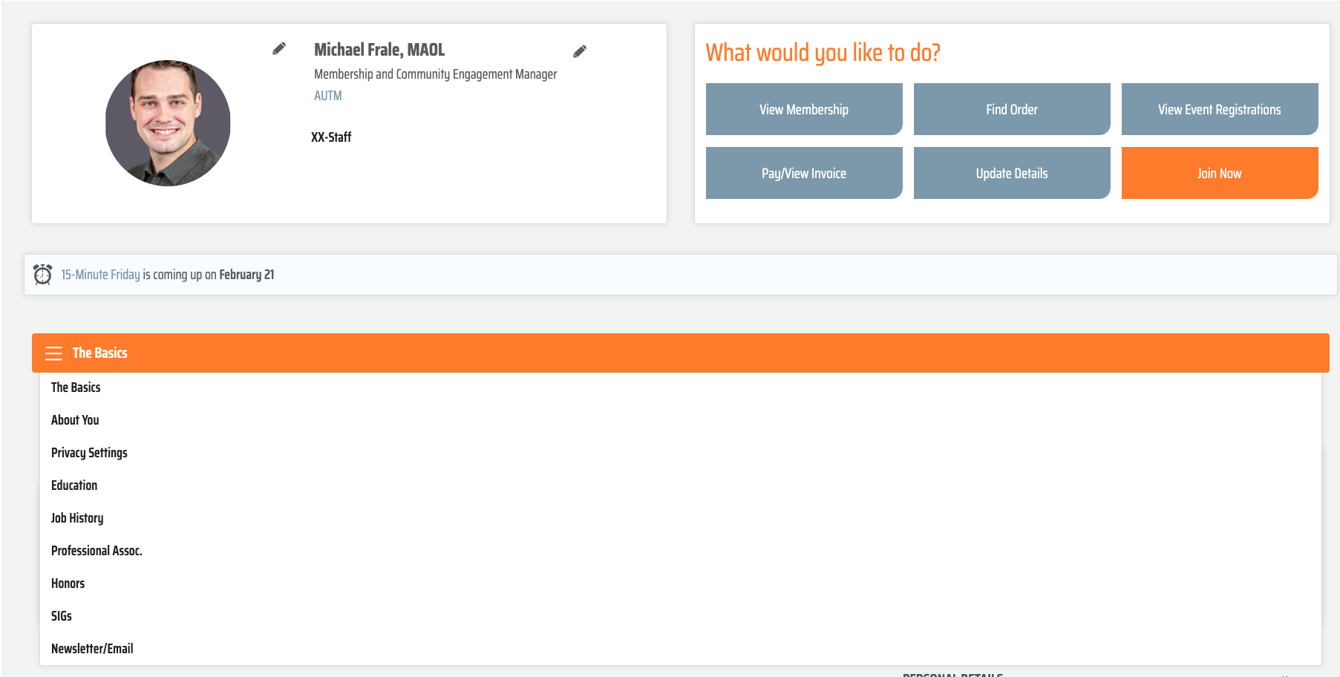
In the past 25 years…
Connect: Internally
Update your profile so that the information is accurate and current!

Slide 10
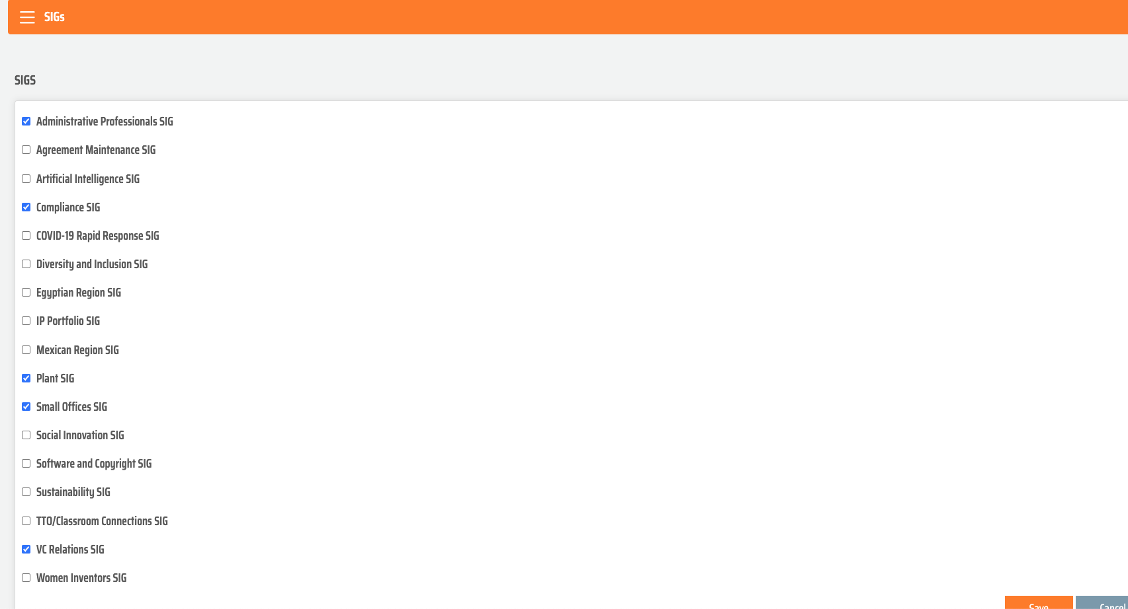
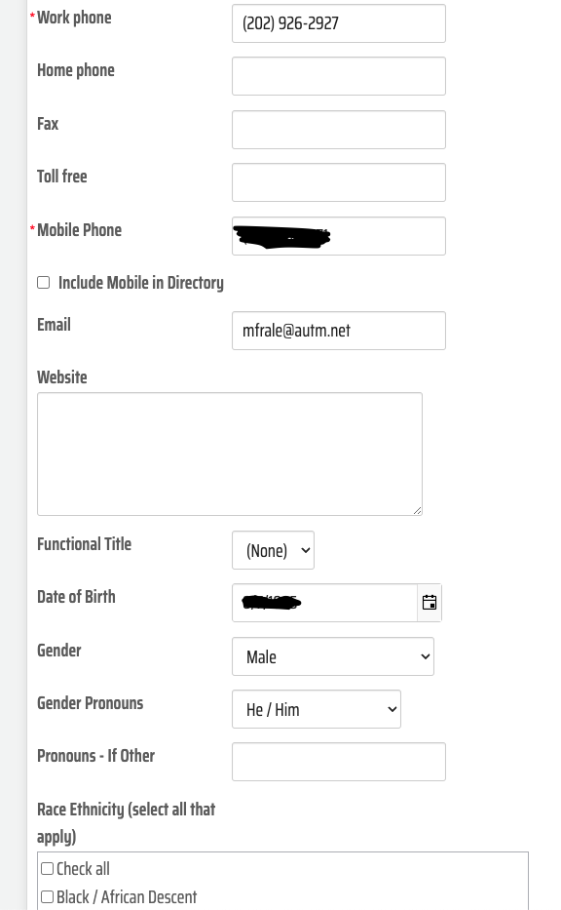
Connect: Internally

Slide 11
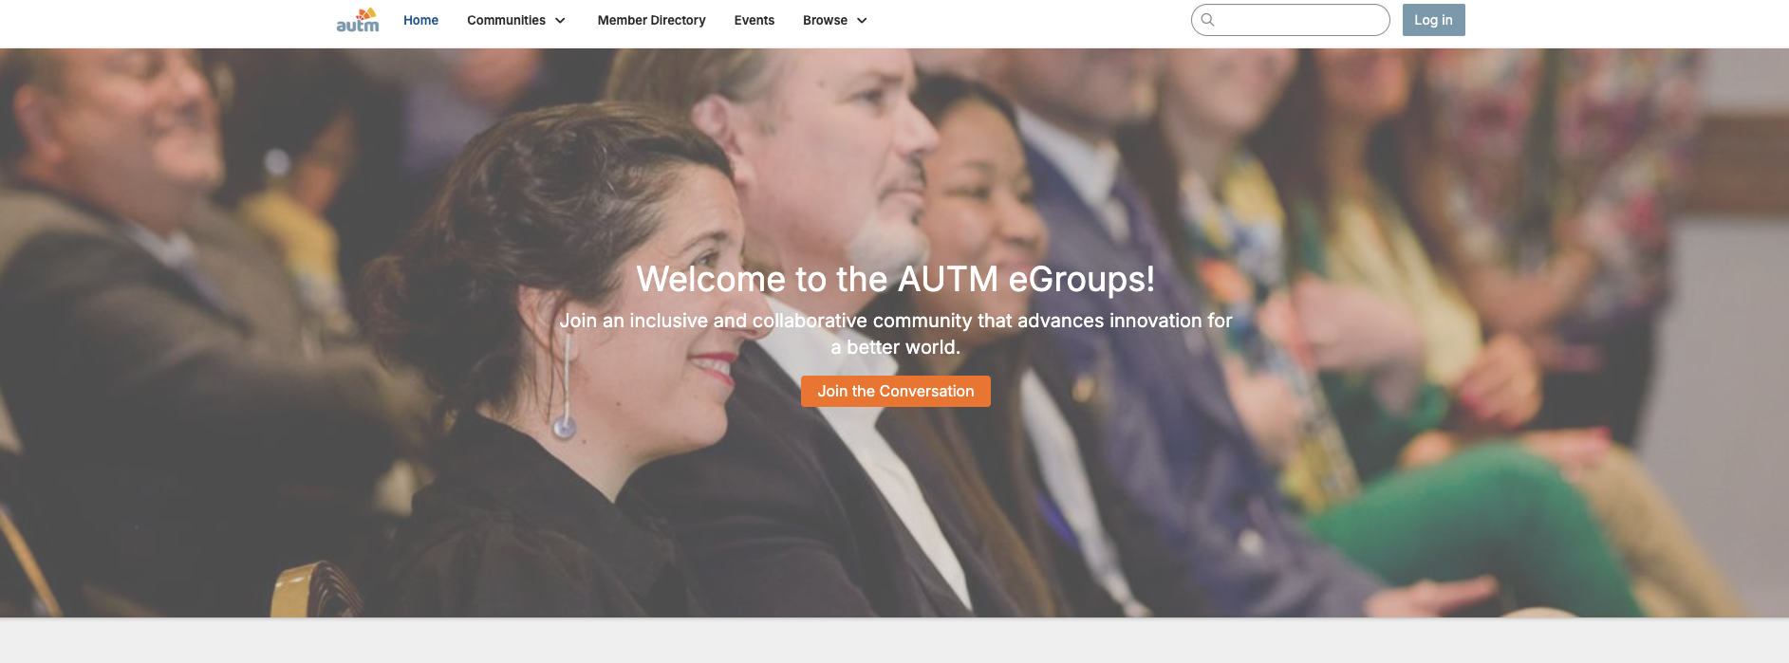
In the past 25 years…
Connect: Internally
Expand your network with the AUTM Membership Directory
Join a Committee
Post on our eGroups
Network with new (and old) colleagues

Slide 12
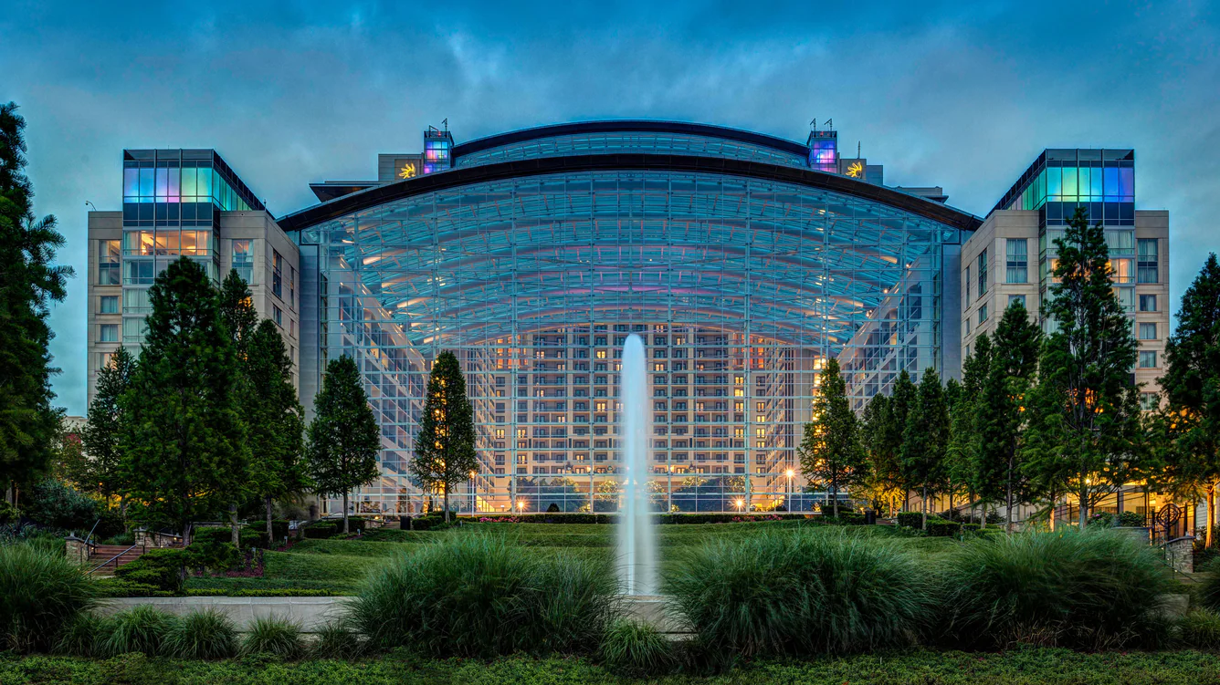
AUTM 50th Anniversary Annual Meeting
2025 Annual Meeting
March 2nd – 5th
2,000+ attendees
100+ sessions
Add-on training courses
Better World Project Awards
1-on-1 partnering opportunities
Hill Visits (Thursday, March 6)
Gaylord National Resort and Convention Center National Harbor, Maryland

Slide 13
Connect: AUTM Meetings and Activities
50th Anniversary Watercooler Series
May 20 - Major Milestones and Transitions Throughout AUTM’s History
August 5 – Growth and Changes in Tech Transfer Over the Years and AUTM’s Impact
November 4 – The Evolution of Tech Transfer and AUTM’s Role in Educating the Field
May 6-8 – 2025 Canadian Region Meeting (Montreal, Canada)
July 21-23 – 2025 Central Region Meeting (Madison, WI)
September 8-9 – 2025 Eastern Region Meeting (Atlanta, GA)
September 30-October 1 – 2025 Western Region Meeting (Salt Lake City, UT)

Slide 14
Helpful Links
Access E-Groups: https://community.autm.net/home
Your Profile: https://shorturl.at/utesZ
Events: https://autm.net/events
Education Courses and Webinars: https://autm.net/careers-and-courses
Surveys & Tools: https://autm.net/surveys-and-tools
Membership: https://autm.net/membership
About AUTM: https://autm.net/about-autm
Better World Project: https://autm.net/about-tech-transfer/better-world-project

Slide 15
Thank you
Contact Me – Let me know any topic ideas!
Mike Frale – mfrale@autm.net
Find AUTM on social media!

