Slide 1
AUTM: Surveys, Tools & Databases
May 23, 2025

Slide 2
Surveys

Slide 3
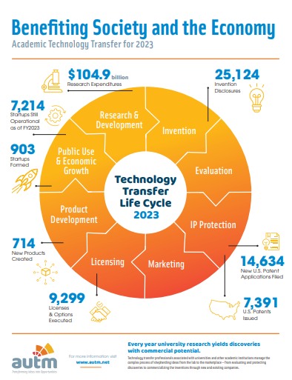
In the past 25 years…
Licensing Activity Survey
Over 30 years Academic Licensing Data
Research Funding
Impact of Innovation
Patent Activity
Licensing Income
Start-ups

Slide 4
Data Submittal
Open to US & Canadian Universities, Institutions and Hospitals
Data is reported annually
Data is submitted through a questionnaire

Slide 5
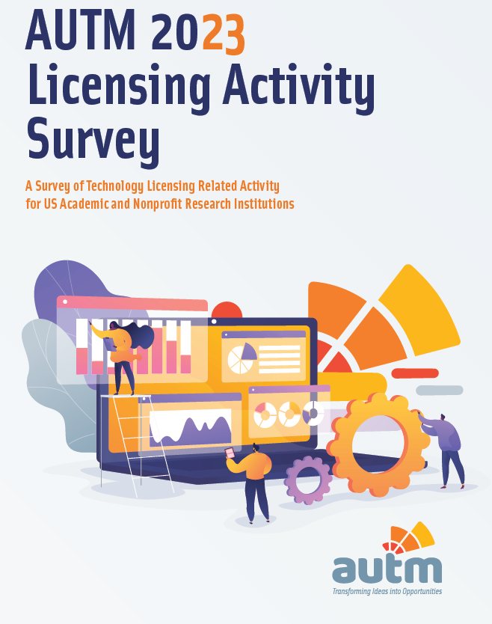
Data Published
Data published yearly
STATT database
PDF form
June 30th – FY24 US Licensing Survey will be published
July – FY24 Canadian Licensing Survey published (Data collection closes May 30^{th)}

Slide 6
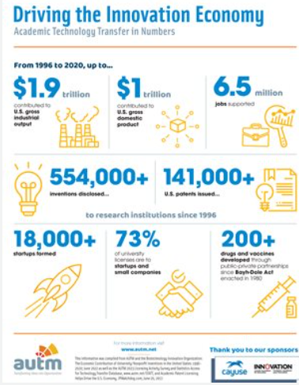
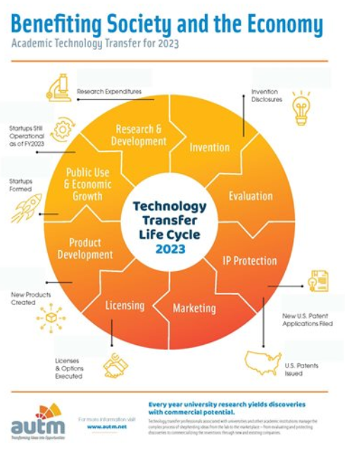
Infographic – US and Canada
Customizable
Filled

Slide 7
2024 Licensing Survey Important Dates
June: Moving all data to new STATT platform (Peerfocus) with release of 2024 Licensing Survey data
June 30th: US Licensing Survey published
July: Canadian Licensing Survey published
Early 2026: Data Collection begin for 2025 Licensing Survey

Slide 8
In the past 25 years…
Biennial 2024 Salary Survey
Industry’s best tool from tracking compensation trends to mapping careers in technology transfer.
Database includes:
Salary statistics
Institutional characteristics
Region, office size, remote work options, incentive compensation
Individual characteristics
Educational degree, gender, experience, number of direct reports

Slide 9
Salary Survey Important Dates
June 20th Data Collection from organizations closes
July 2025 Data published in Peerfocus database

Slide 10
Databases

Slide 11
STATT - Statistics Access for Tech Transfer
Searchable data from past licensing surveys (1991-2023)
Benchmark your office against peer institutions
Track trends on specific Research Institutions or Industries as a whole
Export data for review and analysis
New platform coming with our FY2024 Licensing Survey release
Better functionalities and capabilities
Benchmarking
Graphs/Charts

Slide 12
STATT Data Fields
Staffing
Research Expenditures
Licenses and Options
Institutions
License Income
Disclosures and Patents
Startups
Available Technologies
Survey Year

Slide 13
TransACT – Transactional Academic Comparables Tracking
Powerful comprehensive database of terms and conditions
Improve negotiation using comparable data
Discover alternative pricing or deal structures
Confirm fair market value for transactions

Slide 14
AIM – AUTM Innovation Marketplace
AIM has more innovations listed than any portal of its kind
Showcases university technologies available for licensing
31,000 plus available technologies in the database
More than 2 million page views annual
Upload your available technologies

Slide 15
Tools

Slide 16
Tools
Toolkits
Tech Transfer Manual
PDF
Agreements
Material Transfer Agreements
Model Inter-Institutional Agreement (Model IIA)
US- BOLT Life Science Sample License Agreement
Notes:
Advocacy to Directors toolkit

Slide 17
Any Questions?
Contact
Katie Ventrice – kventrice@autm.net
Find AUTM on social media!

