Slide 2
AUTM is…
AUTM is a non-profit leader in educating, developing, promoting and inspiring technology transfer practitioners to make the world a better place through the commercialization of academic research.
AUTM’s global community of 3,100 members represents businesses and government organizations, and more than 800 universities, research institutions and teaching hospitals.

Slide 3
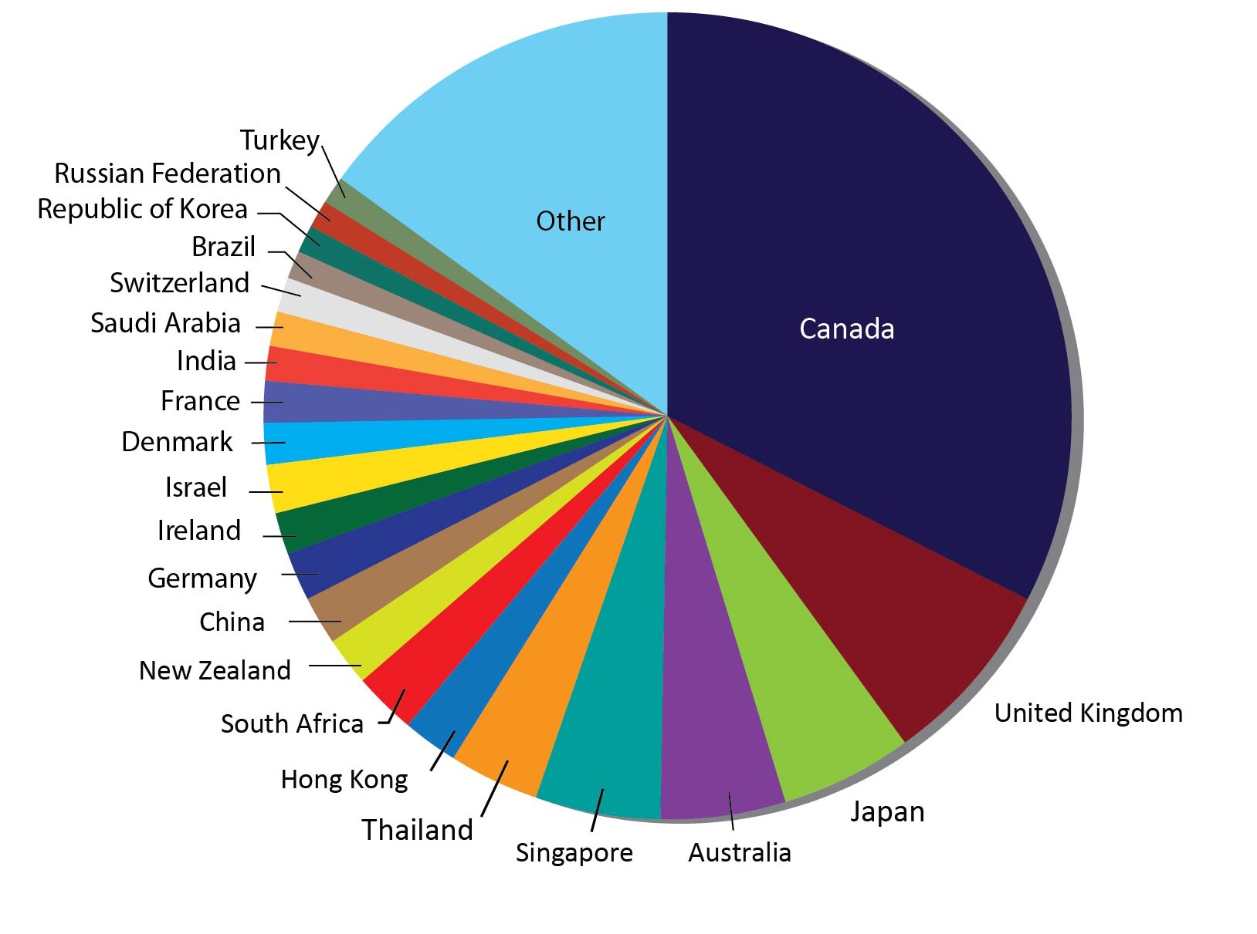
A Global Community
20% of membership is located outside United States
60 countries represented by AUTM membership

Slide 4
Maximizing Impact
Under Bayh-Dole, university and researcher may retain title to inventions made using federal research dollars
This system incentivizes the transfer of technology to the private sector for job creation
Net licensing revenues to universities go back into more research, education, or patenting costs
Initial economic development usually happens locally – more than 70% of start-ups formed each year are located in same state as research institution
Notes:
AUTM U.S. Licensing Activity Survey: FY2016

Slide 5
Moving Ideas Forward
Is this product/invention patentable?
Is there a market for this invention?
Can we find a business interested in licensing, developing and commercializing this technology?
Can we start a new company?
Are there available dollars to help further develop the inventive technology?

Slide 6
Tech Transfer Offices Lend a Hand
Analyzing the marketplace, developing business plans, and understanding patent/licensing issues
Assisting with patent application process
Seeking venture/angel capital
Boosting start-ups through campus-based accelerators, incubators and proof-of-concept programs
Matching researchers with companies looking to license new technologies
Helping faculty grow their technology pipeline

Slide 7
Keys to Success
Dedicated technology transfer and support team
Understanding the marketplace and the local regional economy
Establishing university–private sector relationships that may include additional research funding
Bridging the gap between invention and commercialization
Strong patents
Outstanding researchers doing outstanding research
Long-term financial commitment

Slide 8
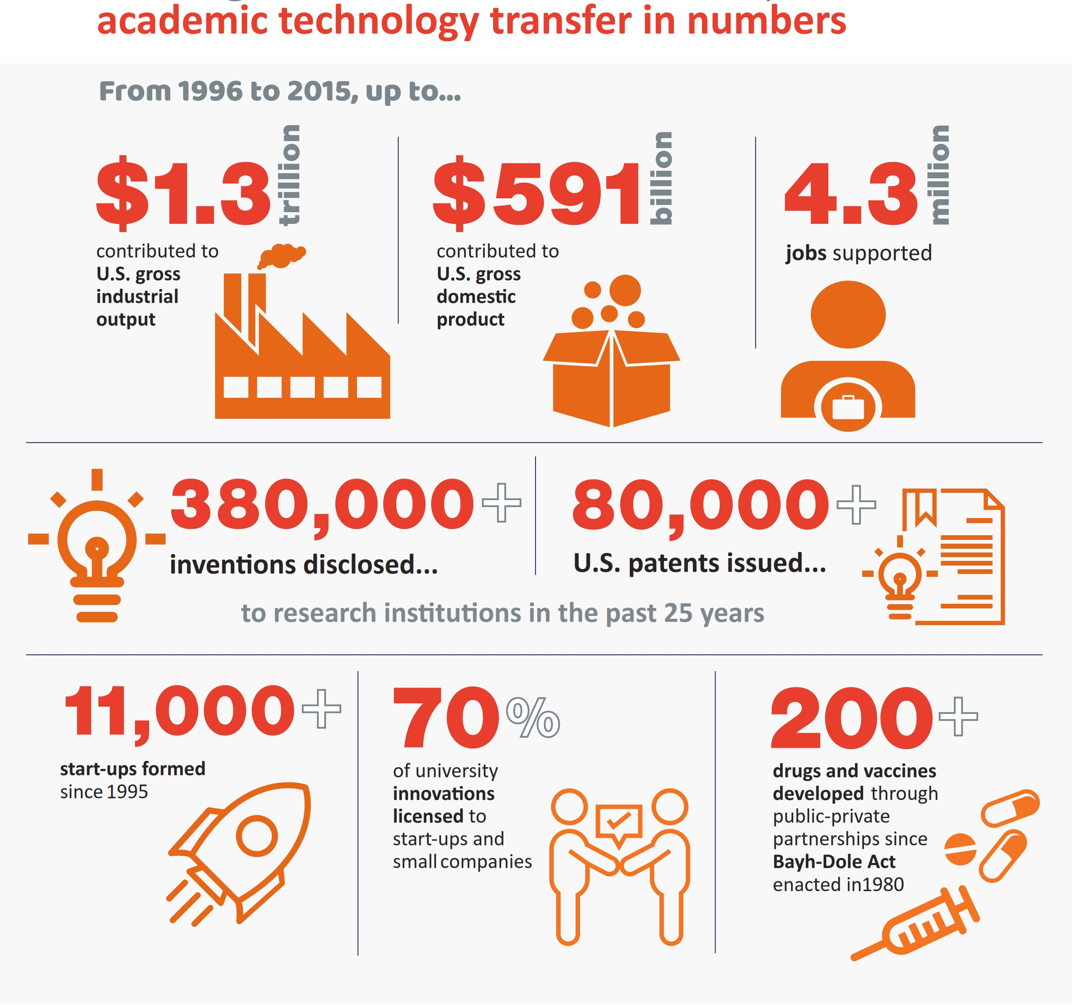
Driving the Innovation Economy
4.3 million jobs supported
$1.3 trillion contributed to economy
Notes:
Independent study commissioned by AUTM and the Biotechnology Innovation Organization (BIO). The report, “The Economic Contribution of University/Nonprofit Inventions in the United States: 1996-2015,” was released in June, 2017.

Slide 9
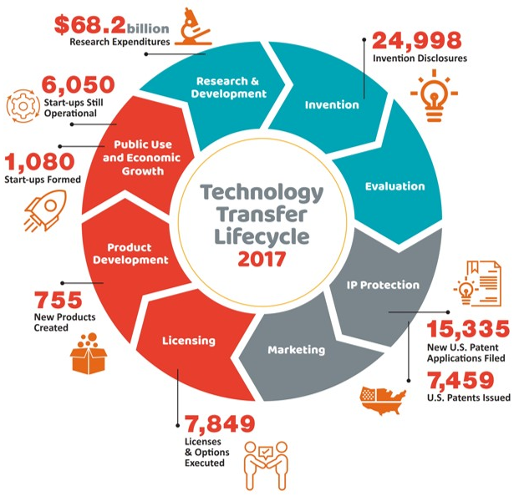
Benefiting Society and the Economy
1,080 start-ups formed
6,050 start-ups still operational at end of FY2017
755 new products created
Notes:
Independent study commissioned by AUTM and the Biotechnology Innovation Organization (BIO). The report, “The Economic Contribution of University/Nonprofit Inventions in the United States: 1996-2015,” was released in June, 2017.

Slide 10
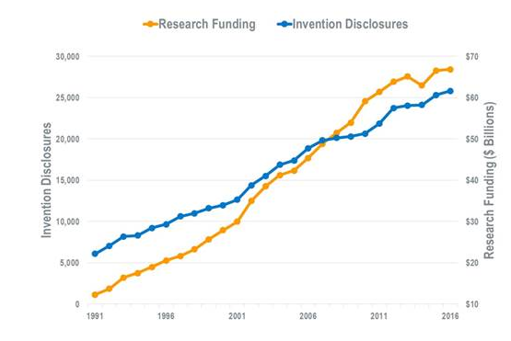
Research Funding Drives Innovation

Slide 11
Role of Policymakers
Provide strong and sustained basic research funding to provide pipeline of great ideas
Ensure that patent rights are protected for a given university, researcher, and the government
Encourage policies that attract venture capital support
Support SBIR/STTR and other translational initiatives
Support the Bayh-Dole Act
Do nothing to inhibit American ingenuity and innovation, which leads the world

Slide 12
Connect with AUTM
Follow @AUTM
Like Association of University Technology Managers
Follow Association of University Technology Managers
View AUTMNetwork

